Slide 1
Introducing the Makerspace
Rich Jenkins, IDEA Hub Coordinator
01 March 2023

Slide 2
Objectives
Describe what the makerspace should accomplish
Show details of available tooling systems

Slide 3
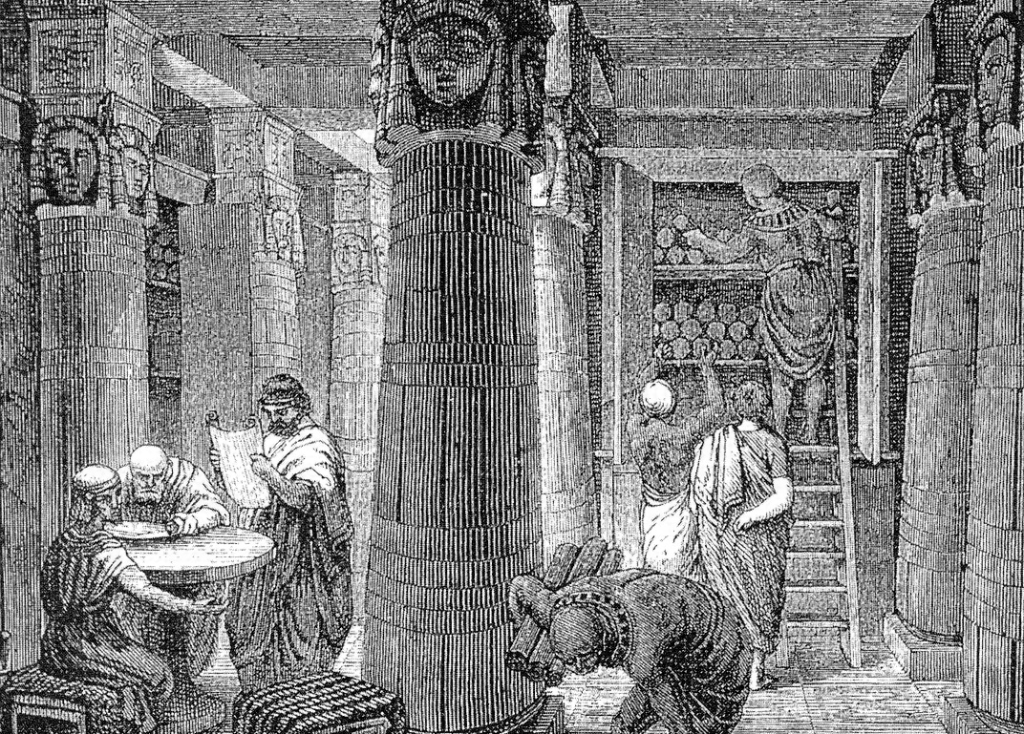
Libraries as Technology Hubs
Providing local access to
Subject matter expertise
Innovation
Technical services

Slide 4
Dreaded Icebreaker
Please introduce yourself and tell us,
when you heard the very first time that Creighton was opening a makerspace, what did you imagine would be there, and what did you want to create?

Slide 5
A Makerspace in the Library
for the Creighton community to have useful and accessible tools
for design and prototyping of new concepts
to encourage innovation
to teach technology skills

Slide 6
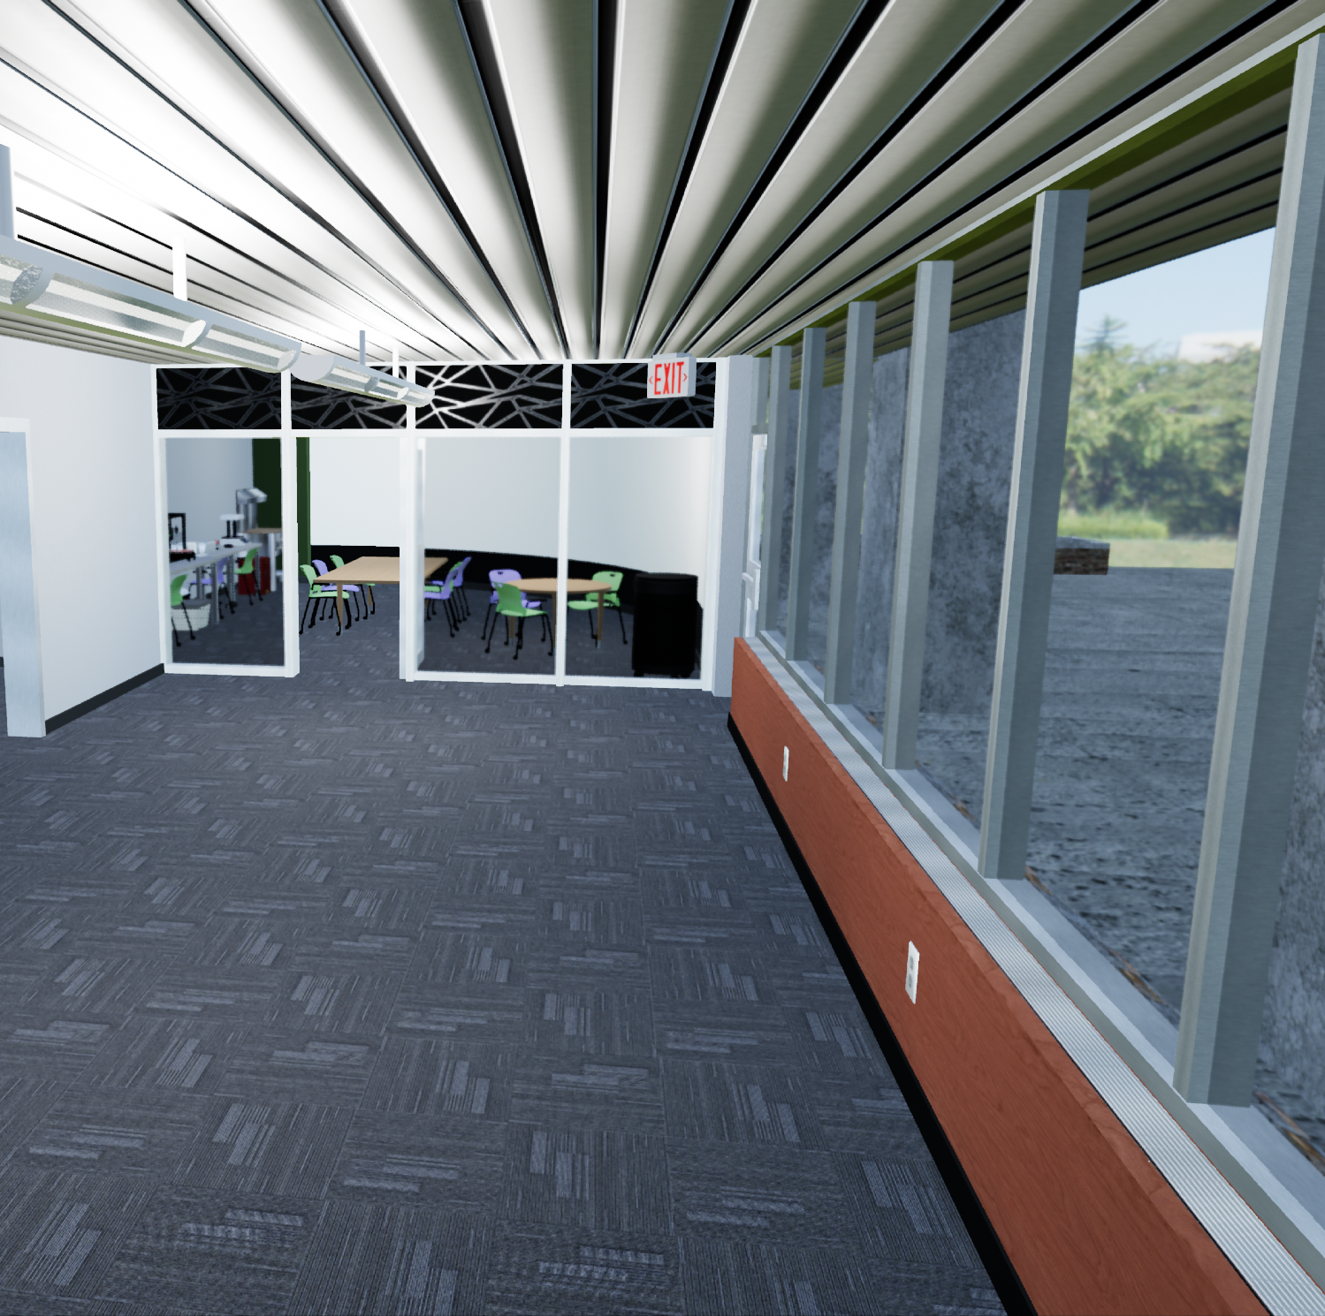
Where is the makerspace?
RAL 108 (the CAVE) starting after Spring Break 2023
Also available virtually in Sansar
  (very limited staffing)

Slide 7
Who are our makers?
Stewarded by Creighton library IDEA Hub and Access Services staff and interns
Serving Creighton library patrons, particularly students, faculty, and staff

Slide 8
Tooling Overview
Design
Additive manufacturing
Traditional manufacturing
Modifications and repairs

Slide 9
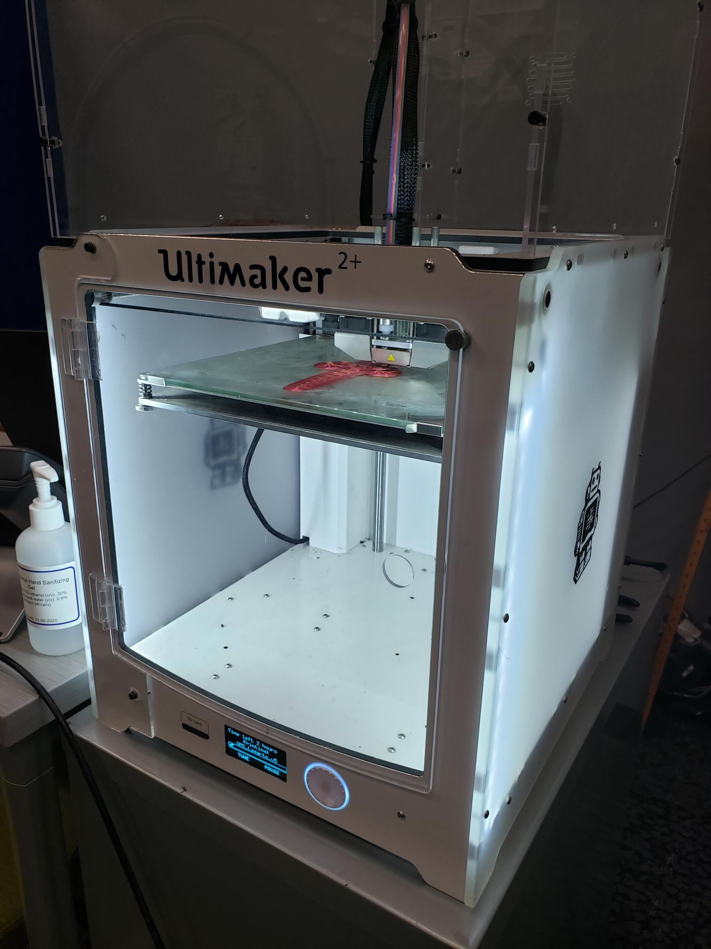
Tooling, Ultimaker 2+ FDM 3D Printer
Working area 223mm x 223mm x 205mm
2.85mm filament
0.02mm resolution
*.stl or *.obj files, requires slicing software

Slide 10
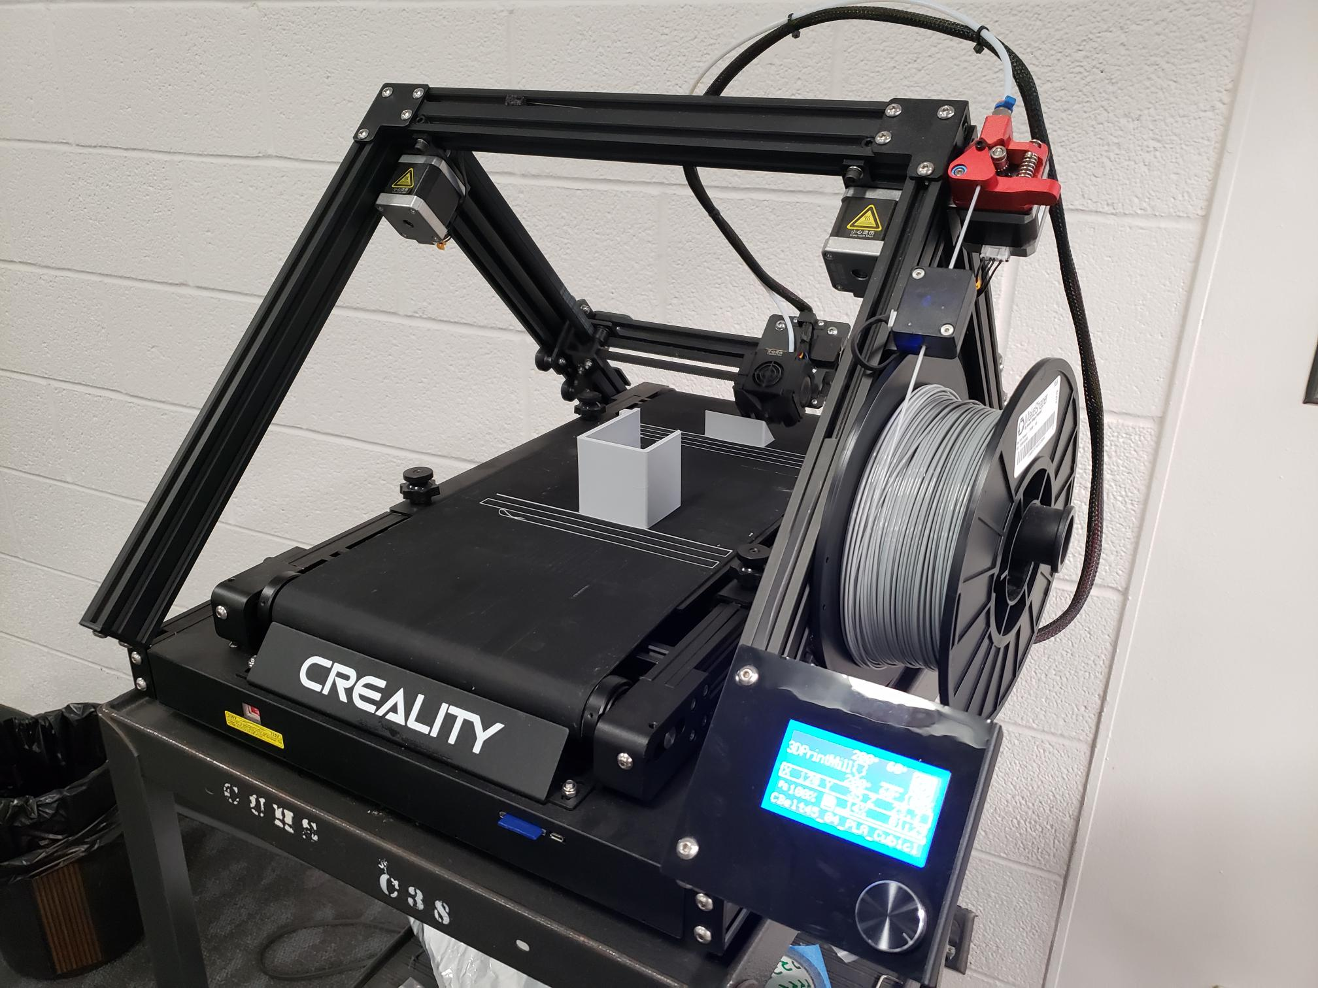
Tooling, Creality CR-30 FDM 3D Printer
Working area 200mm x 170mm x unlimited
1.75mm filament
0.1mm resolution
*.stl or *.obj files, requires slicing software

Slide 11
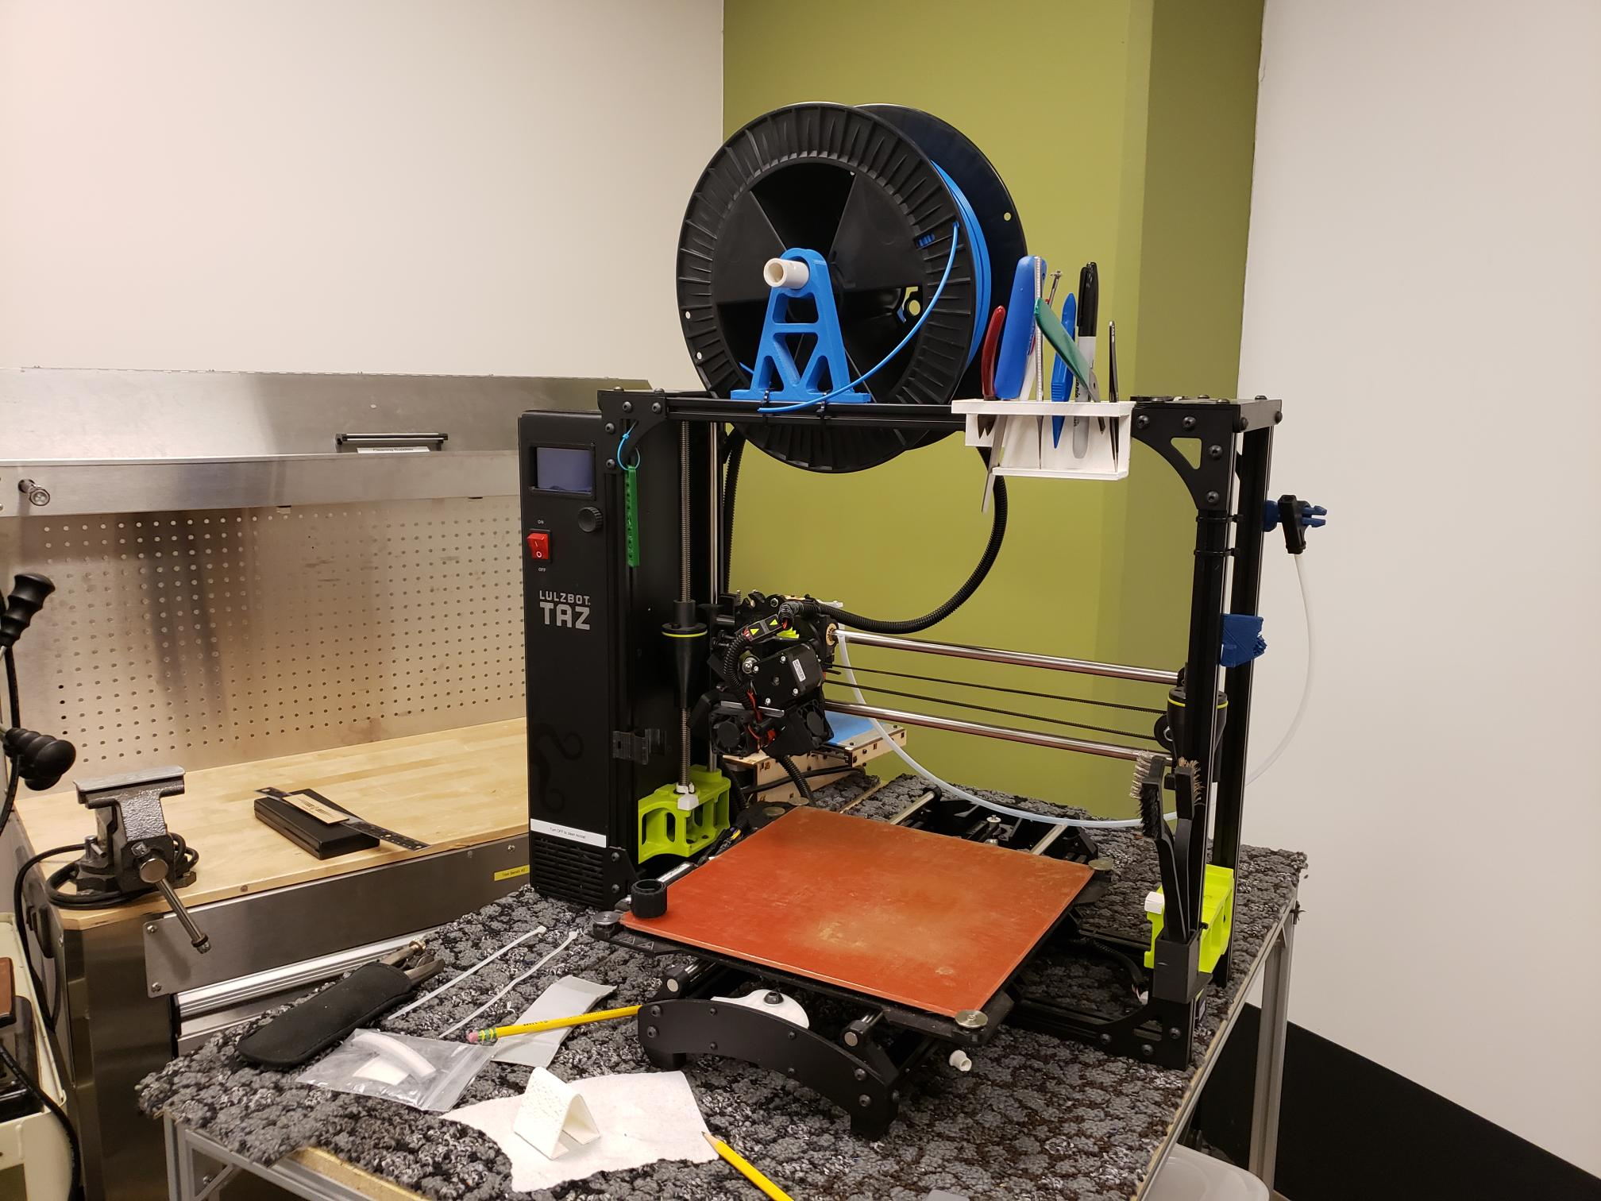
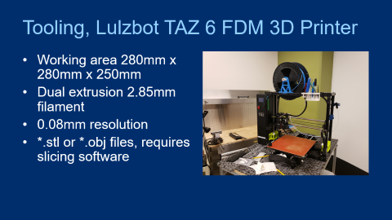
Tooling, Lulzbot TAZ 6 FDM 3D Printer
Working area 280mm x 280mm x 250mm
Dual extrusion 2.85mm filament
0.08mm resolution
*.stl or *.obj files, requires slicing software

Slide 12
Tooling, Prusa SL1S MSLA 3D Printer
Working area 127mm x 80mm x 150mm
405nm cured resin
0.025mm resolution
*.stl or *.obj files, requires slicing software

Slide 13
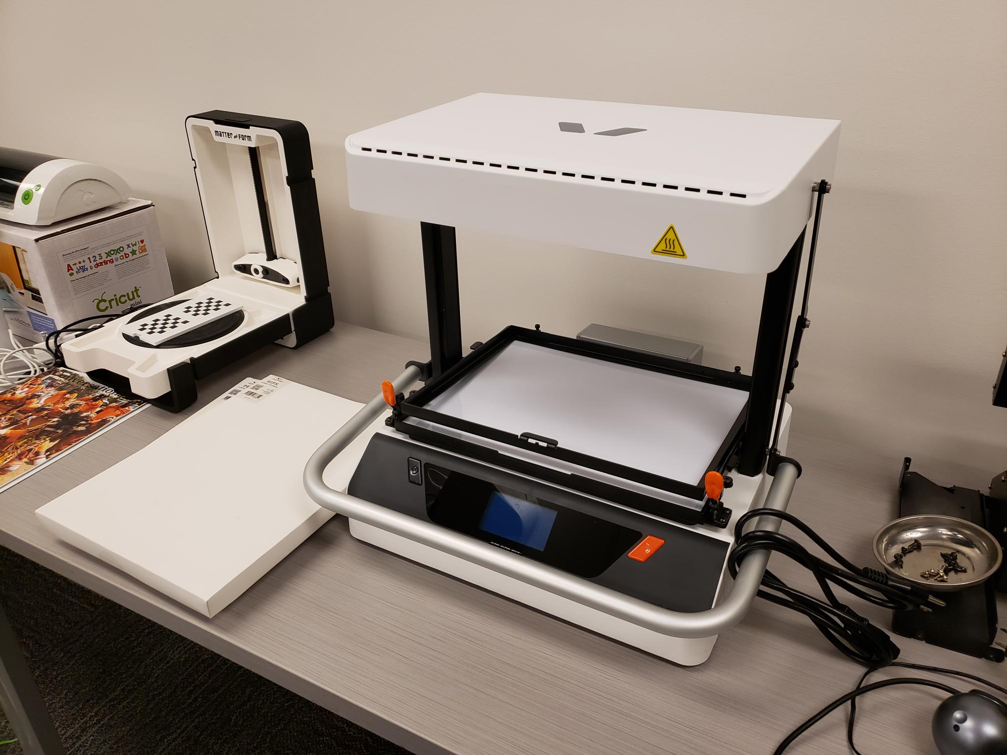
Tooling, Vaquform DT2 vacuum former
Working area 330mm x 250mm x 200mm
0.2 to 3.0mm plastic sheet
Requires a physical mold

Slide 14
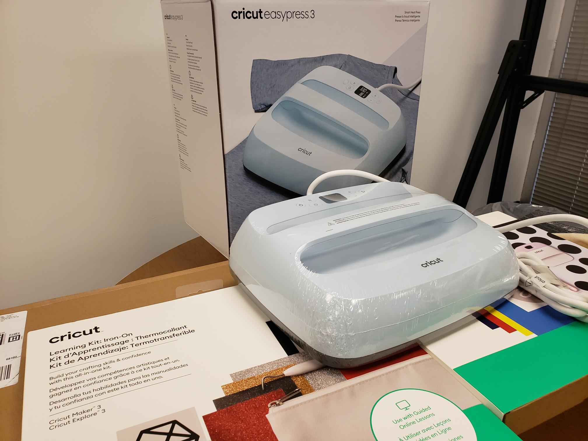
Tooling, Cricut EasyPress 3 thermal press
Working area 12in x 10in
Thermal transfer
The object receiving the print must be heat tolerant

Slide 15
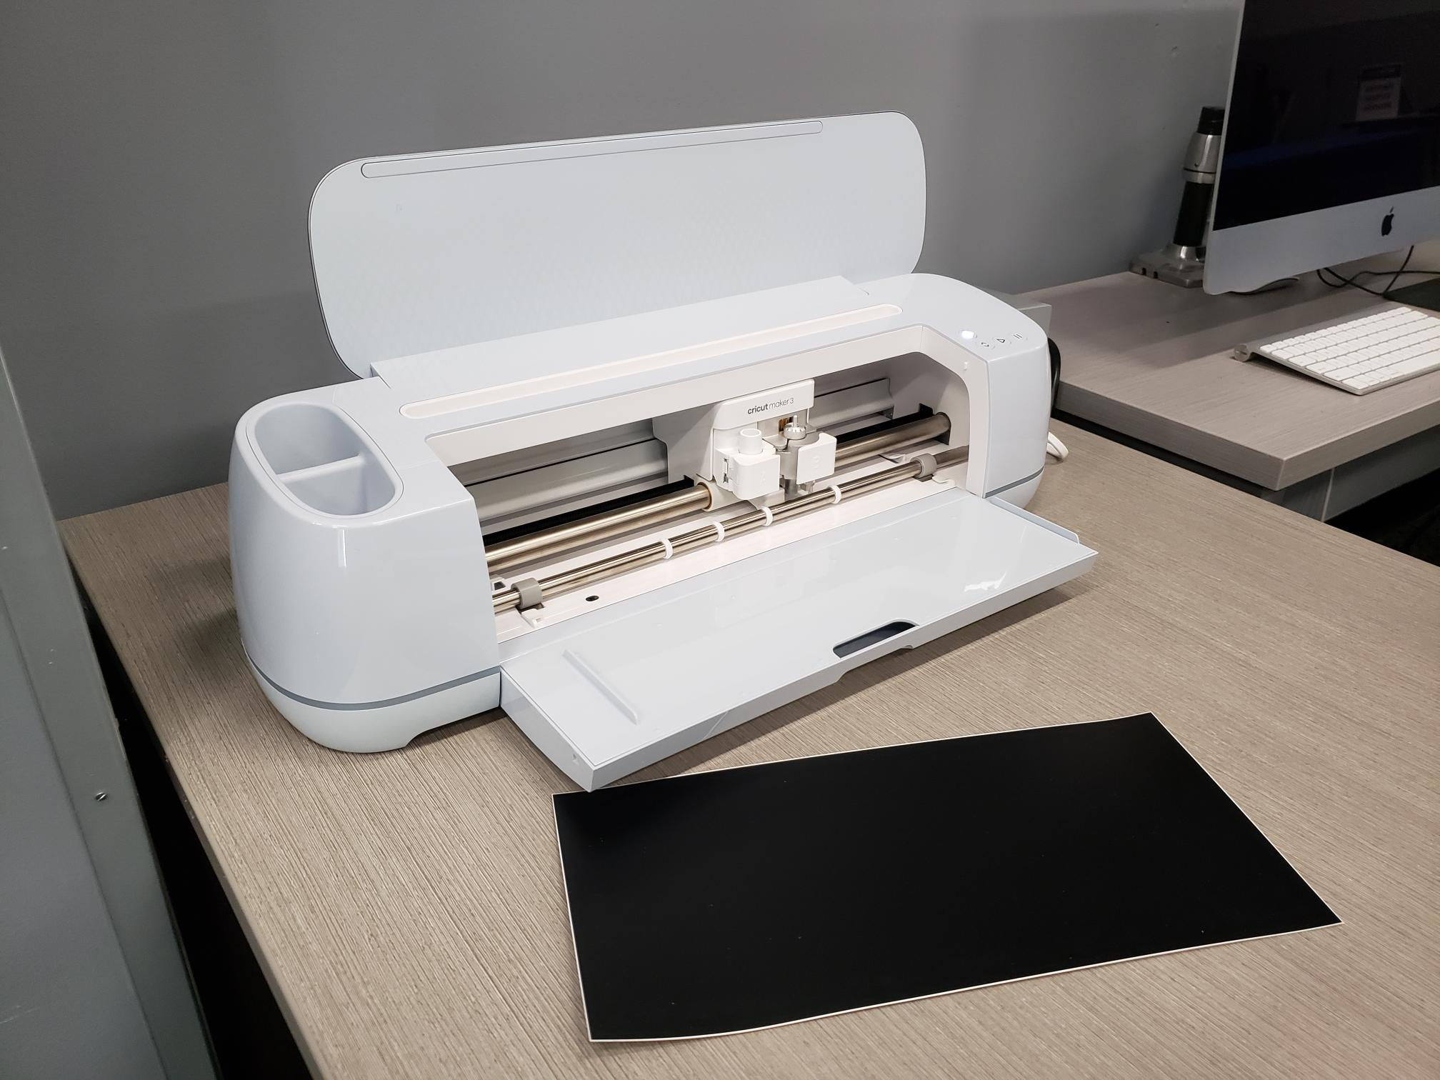
Tooling, Cricut Maker cutting machine
Working area 11.5in x 23.5in
Flexible sheet materials

Slide 16
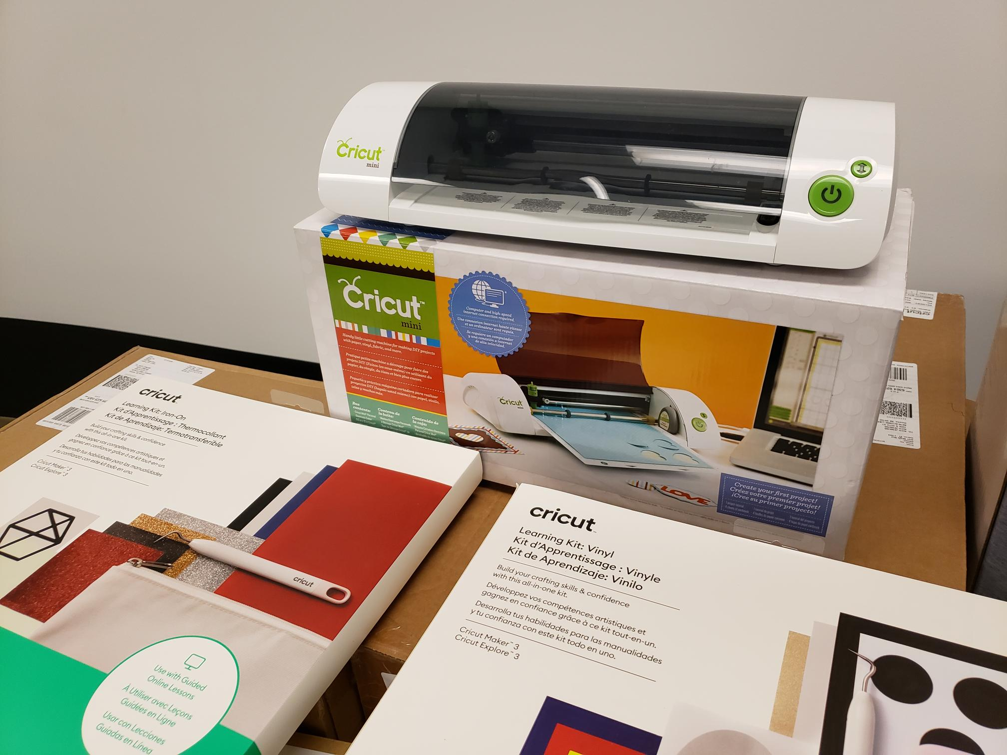
Tooling, Cricut Mini cutting machine
Working area 8.5in x 12in
Flexible sheet materials

Slide 17
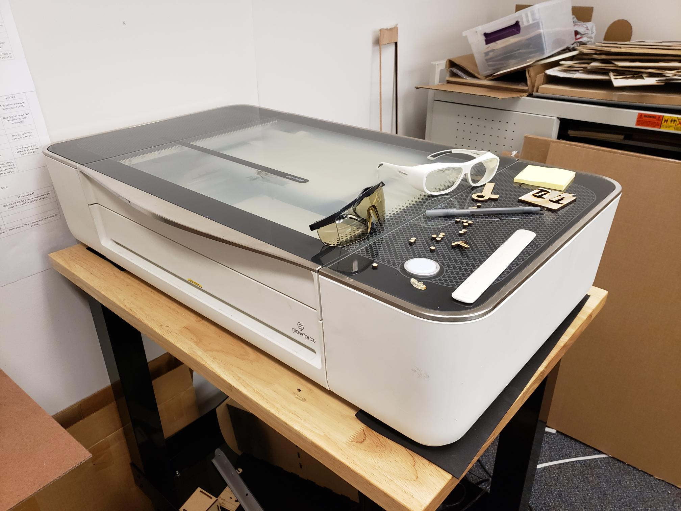
Tooling, Glowforge laser cutting machine
Working area 11in x 19.5in x 2in
Wood, leather, acrylic, paper
*.svg files, requires Glowforge software platform

Slide 18
Thank you! Please come build a new thing, we’re here to help.

